Slide 1
INVESTMENT ADVANTAGES
OF ŁOMŻA REGION

Slide 2
ŁOMŻA AND DISTRICT – GENERAL INFORMATION
The area is 1.380 km2 with a population of almost 115.000 inhabitants (Łomża – 32 km2, 63.000 inhabitants)
Łomża and Łomża District are located in the west part of the Podlaskie Voivodship, in the north-eastern Poland.
Region is situated in the „Green Lungs of Poland”.

Slide 3
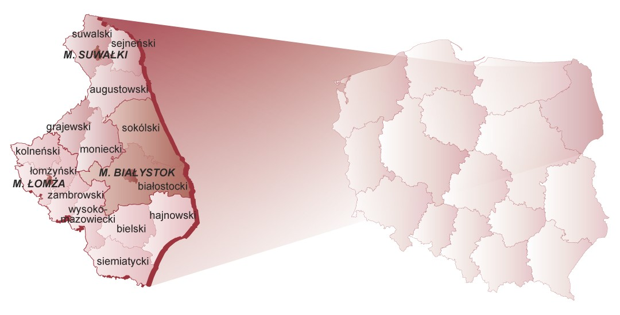
ŁOMŻA AND DISTRICT – GENERAL INFORMATION

Slide 4
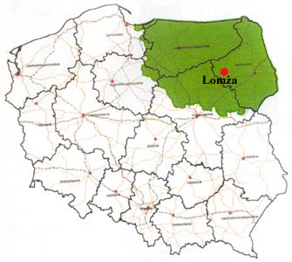
THE „GREEN LUNGS OF POLAND”
These unique region is characterized by:
low density of population,
non polluted environment, calmness and attractive land for tourists,
the possibility of communing with nature not changed by civilization
richness and diversity of nations, cultures, and traditions
academic potential.

Slide 5
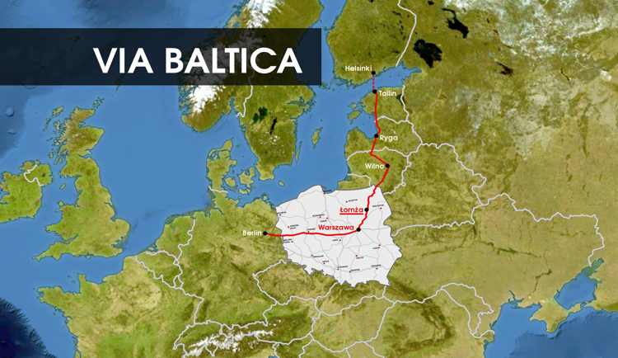
WHY IS IT WORTH TO INVEST IN ŁOMŻA REGION?
The location
Short distance to the center of Poland and only 140 km to capital city as well as to eastern and northern borders of Poland.
Two national roads 61 and 63 run through the city.
The trans-european transport corridor called "Via Baltica" linking the countries of Western Europe with the Baltic countries will be built soon here.

Slide 6
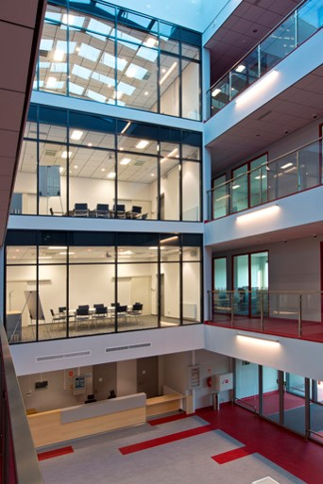
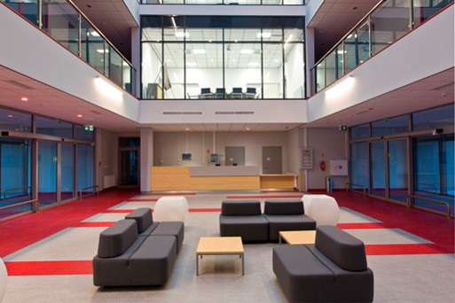
WHY IS IT WORTH TO INVEST IN ŁOMŻA REGION?
The Łomża Subzone of the Special Economic Zone and the Industrial Park with business incubator.
Industrial Park creates the Economic Activity Zone dedicated to small and medium-sized entrepreneurs. This place is dedicated also to graduates who would like to set their business without any taxes and costs as a start-up in Academic Business Incubator. The combination of Industrial Park and an Academic Business Incubator creates ecosystem which enables developing business ideas.
Industrial Park offers:
offices rent (incubation)
pre-incubation – cooperation with ABI
virtual office service
server room – 120 m2 area
consultings/ trainings

Slide 7
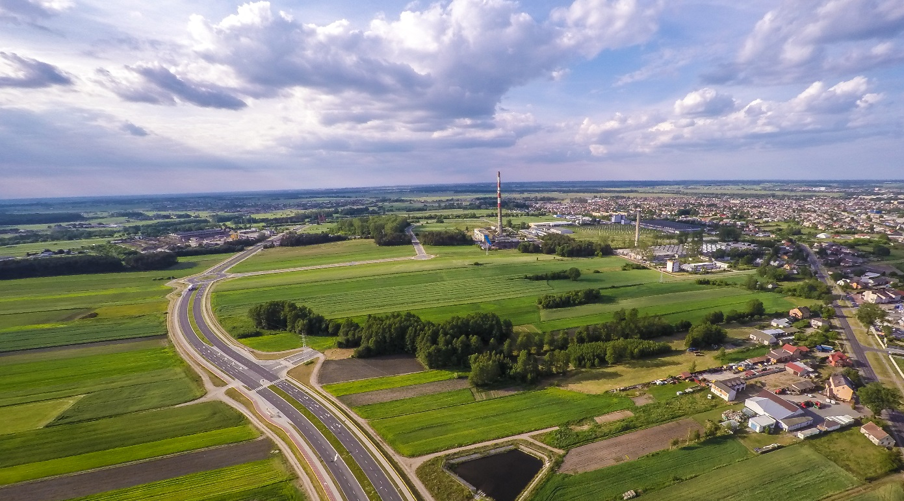
WHY IS IT WORTH TO INVEST IN ŁOMŻA REGION?
The height of public aid up to 70%
The Łomża Subzone of the Special Economic Zone
The height of state aid is up to 70%, which means that potential investor can receive:
financial support from european funds on the highest level in Poland
income tax exemption up to 70% of investment outlays, leading their activity in Subzone of Special Economic Zone
property tax exemption for maximum 6 years offered by our city
available area - approximately 150 ha
with necessary infrastructure
with the access to the national road 61
near VIA Baltica

Slide 8
WHY IS IT WORTH TO INVEST IN ŁOMŻA REGION?
Human resourses
Two schools of higher education: the Łomża State University of Applied Sciences and the Academy of Agribusiness educate in the following directions: computer science, automatics and robotics, food technology, construction and agriculture.
4.000 students.
Low labour costs. Average monthly gross salary is about 740 Euros.

Slide 9
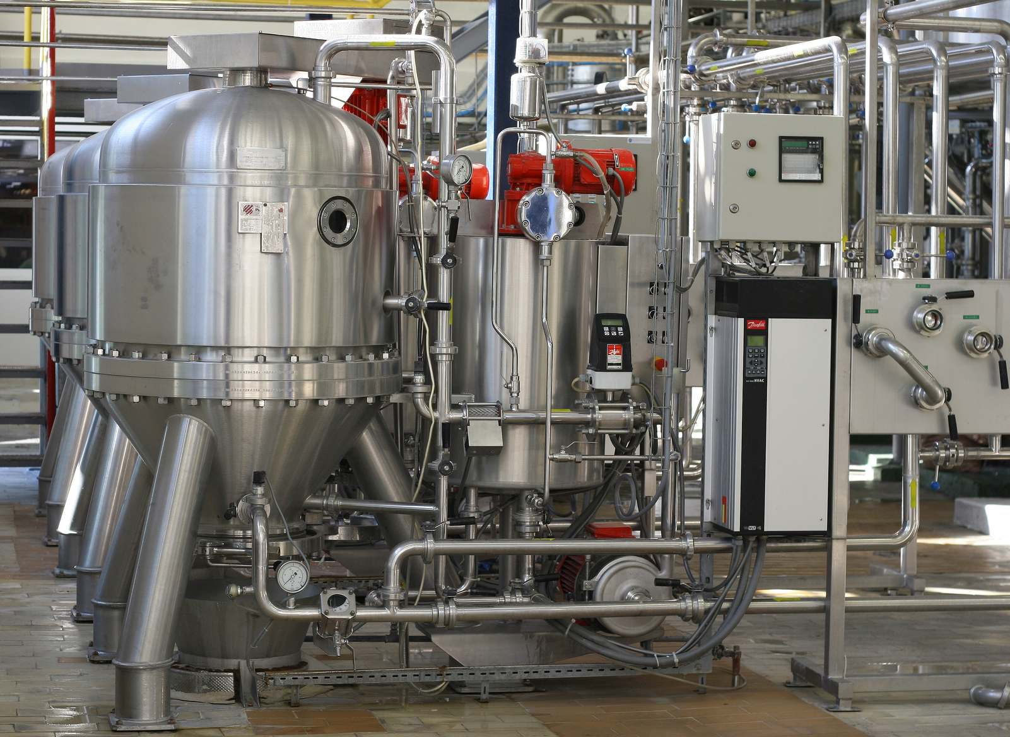
WHY IS IT WORTH TO INVEST IN ŁOMŻA REGION?
The location of the „Green Lungs of Poland” promotes the development of the food industry, construction and building industry, IT industry.
The largest dairy producers in Poland, the largest manufacturer of potato starch and derivatives, brewery are located in the city or nearby. The modern and innovative companies in the branches of construction and food industry are functioning here.

Slide 10
THE STRUCTURE OF COMPANIES IN ŁOMŻA
6.315 enterprises are functioning in Łomża (9.400 including Łomża District)
97,5 % in private sector
2,5 % in public sector The location of the „Green Lungs of Poland” promotes the development of the food industry, construction and building industry, IT industry.
The size of the enterprises:
96% micro-enterprises
4 % small and middle enterprises
there are only few big companies
Leading branches:
food industry
building industry
furniture industry
IT industry
transport

Slide 11
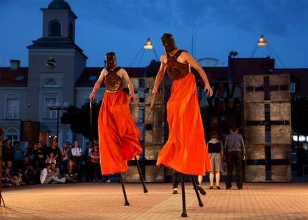
WHY IS IT WORTH TO INVEST IN ŁOMŻA REGION?
The quality of life
Location by the Narew River, surrounded by landscape parks and nature reserves.
Clean and quiet place to live.
Attractions: Biebrza National Park, the waterway of King Stefan Batory, the groups of defensive forts, the outdoor museum of Kurpie in Nowogród.
Cultural institutions: The Puppet and Actor Theatre, museums, galleries.
Events: International Theatre in Suitcase, National Competition Whirling Dance Zone, Festival Music Days Drozdowo Łomża.

Slide 12
Contact us
The Entrepreneurs Assistance Center
The City Hall of Łomża
Stary Rynek 14, 18-400 Łomża
Phone +48 86 2156852
Mail: cop@um.lomza.pl
Website: www.biznes.um.lomza.pl

